Slide 1
Torque Vectoring
H Hari Narayanan (ME18MTECH11017)
Arnab Biswas (ME18MTECH11001)
Hariprakash M (ME18MTECH11018)
Sibivivek (ME19MTECH01003)
Pranav (ME19MTECH01001)

Slide 2
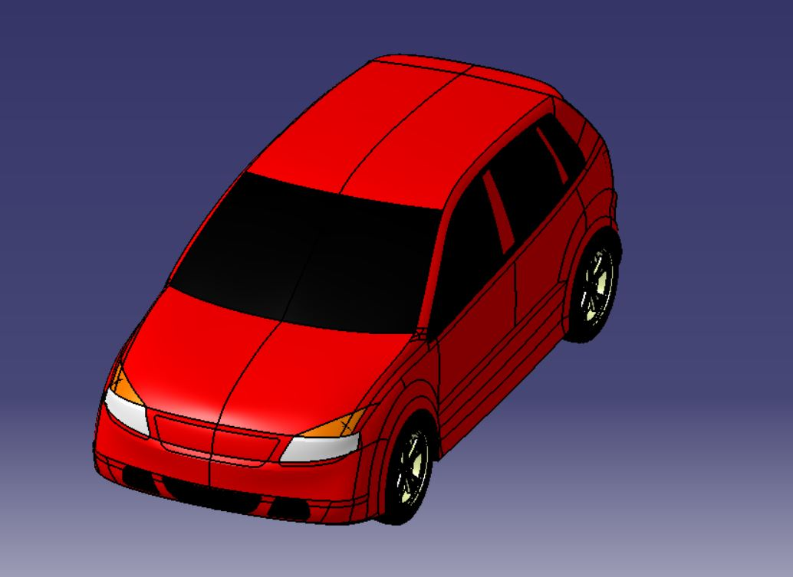
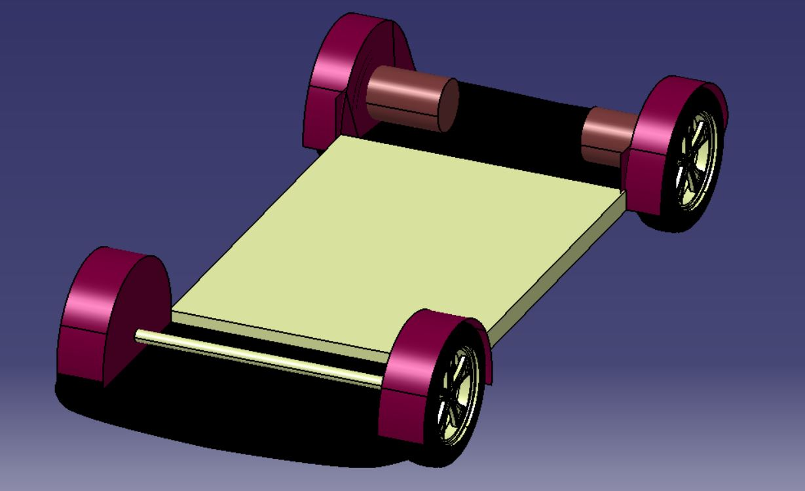
A Simple 3D Hatchback Model – CATIA V5

Slide 3
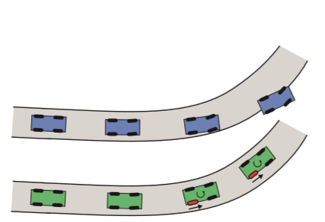
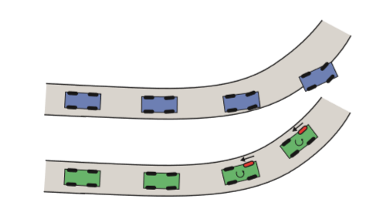
What is Torque Vectoring?
The ESP is a prevalent stability system present in most of the automobiles.
The ESP uses wheel braking to control the yaw moment given to the vehicle to stabilise the vehicle during navigation of turns. The difference in the braking forces in the wheels generates the yaw moment which is advantageous in critical situations to decelerate the vehicle.
ESP in an understeer vehicle
TV in an understeer vehicle

Slide 4
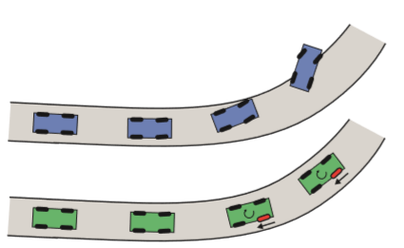
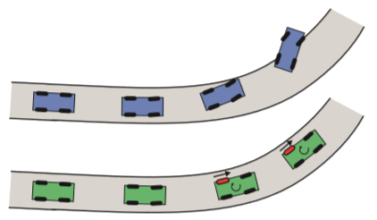
ESP in an oversteer vehicle
TV in an oversteer vehicle
ESP stabilises the vehicle by slowing down the vehicle which is undesirable in cases where the driver intends to accelerate the vehicle.
Torque Vectoring systems do not slow down the vehicle as there is no braking rather only a redistribution of torques between the two wheels of the driven axle.
Torque Vectoring Systems help redistribute torques to wheels under different traction conditions. An ECU combined with sensors deliver inputs like tractions, yaw rates, lateral accelerations to the ECU which then decides to distribute the power accordingly as Front-Rear, Left-Right or All Wheels.

Slide 5
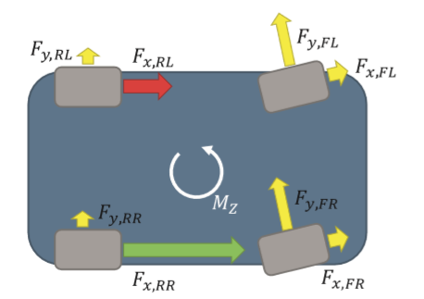
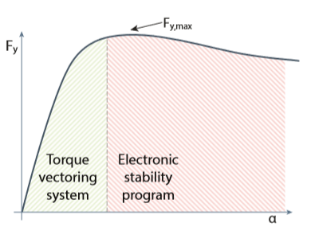
As there is no change in the longitudinal forces, there is no slowing down of the vehicle.
As the torque is redistributed, a yaw moment is given to the vehicle which corrects the path of the vehicle

Slide 6
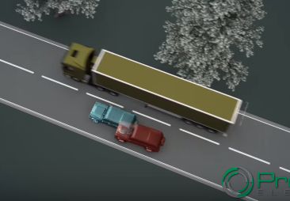
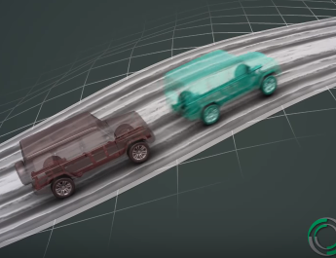
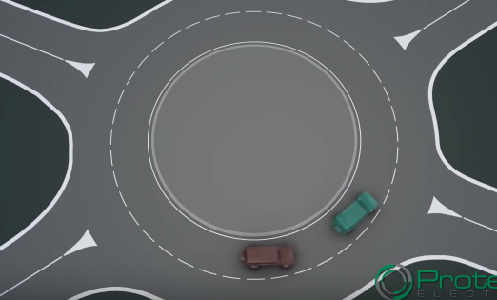
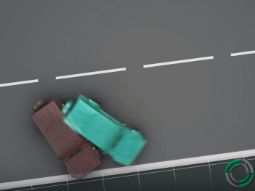
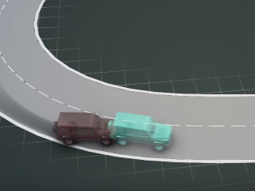
Torque Vectoring Application scenarios
Permits high cornering speeds
Sudden lane change stability
Traction Control
Low Speed Driving
Manoeuvrability
Active Safety

Slide 7
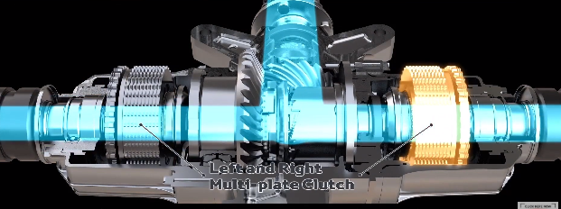
Torque Vectoring with electronic control systems detect the traction at the different wheels and redistribute the power to the wheel with better traction.
The distribution can be front-rear or left-right depending on the differential present. Electric systems respond much faster and the response is less complex as the torque/power is variable at each of the driving motors.
Application of clutch plates with hydraulic actuators to
Distribute power between the wheels

Slide 8
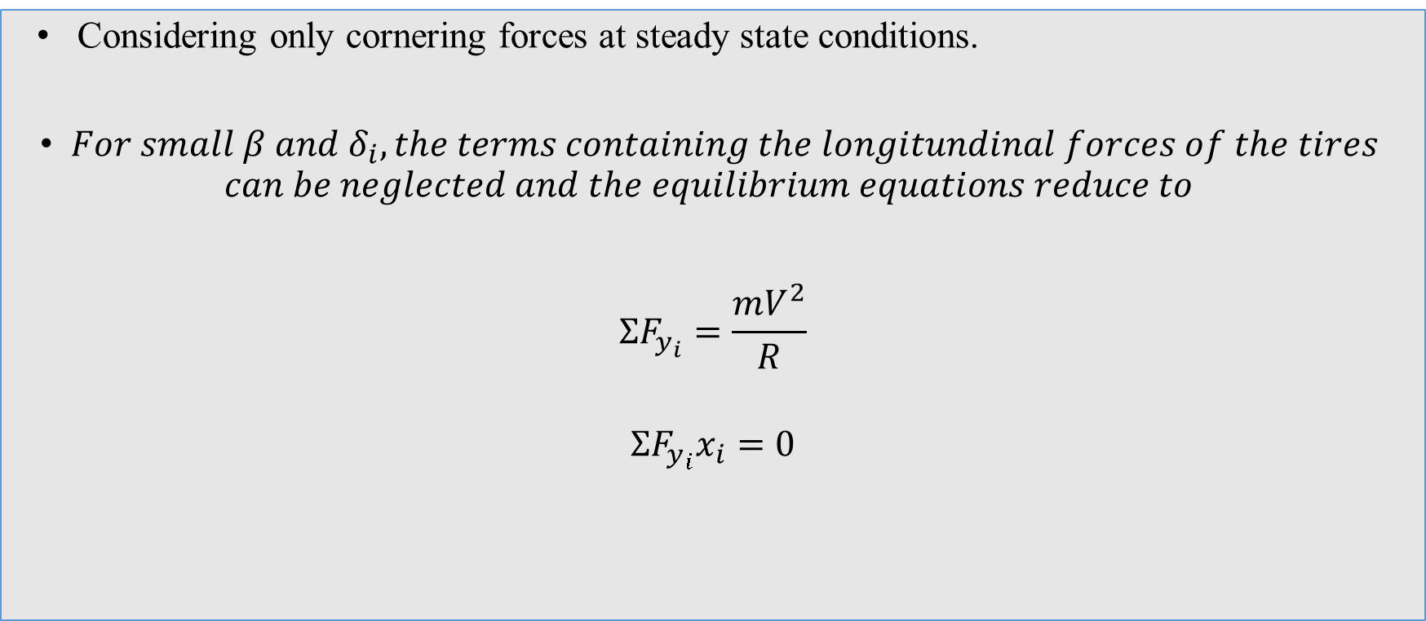
Governing Equations
Considering only cornering forces at steady state conditions.
$For small β and δ_{i}, the terms containing the longitundinal forces of the tires$ $can be neglected and the equilibrium equations reduce to$
$$ΣF_{y_{i}}=\frac{mV^{2}}{R}$$
$$ΣF_{y_{i}}x_{i}=0$$

Slide 9
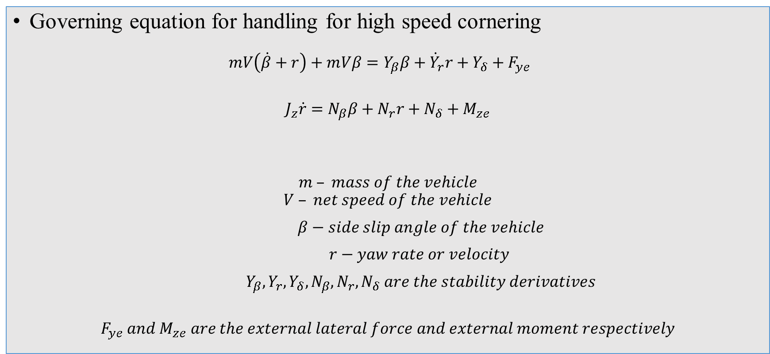
Governing Equations
Governing equation for handling for high speed cornering $mV\left(\dot{β}+r\right)+m\dot{Vβ=Y_{β}β+Y_{r}r+Y_{δ}+F_{ye}}$
$$J_{z}\dot{r}=N_{β}β+N_{r}r+N_{δ}+M_{ze}$$
$$m – mass of the vehicle$$
$$V – net speed of the vehicle$$
$β−side slip angle of the vehicle$
$r−yaw rate or velocity$
$Y_{β},Y_{r},Y_{δ},N_{β},N_{r},N_{δ} are the stability derivatives$
$$F_{ye} and M_{ze} are the external lateral force and external moment respectively$$

Slide 10
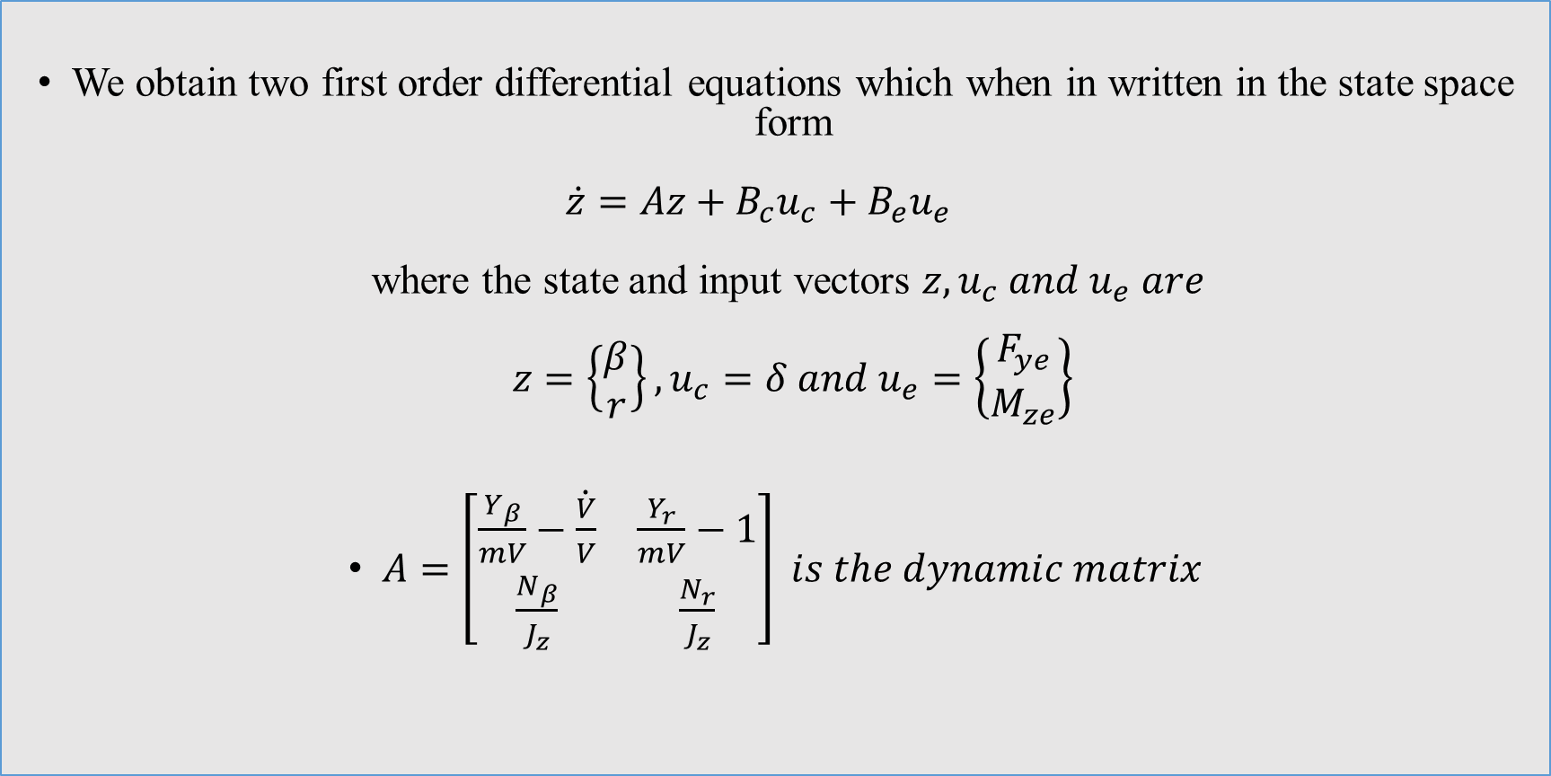
We obtain two first order differential equations which when in written in the state space form $\dot{z}=Az+B_{c}u_{c}+B_{e}u_{e}$ where the state and input vectors $z, u_{c} and u_{e} are$ $z=\left\{\begin{matrix}β \\ r\end{matrix}\right\}, u_{c}=δ and u_{e}=\left\{\begin{matrix}F_{ye} \\ M_{ze}\end{matrix}\right\}$
$A=\left[\begin{matrix}\frac{Y_{β}}{mV}−\dot{\frac{V}{V}} & \frac{Y_{r}}{mV}−1 \\ \frac{N_{β}}{J_{z}} & \frac{N_{r}}{J_{z}}\end{matrix}\right] is the dynamic matrix$

Slide 11
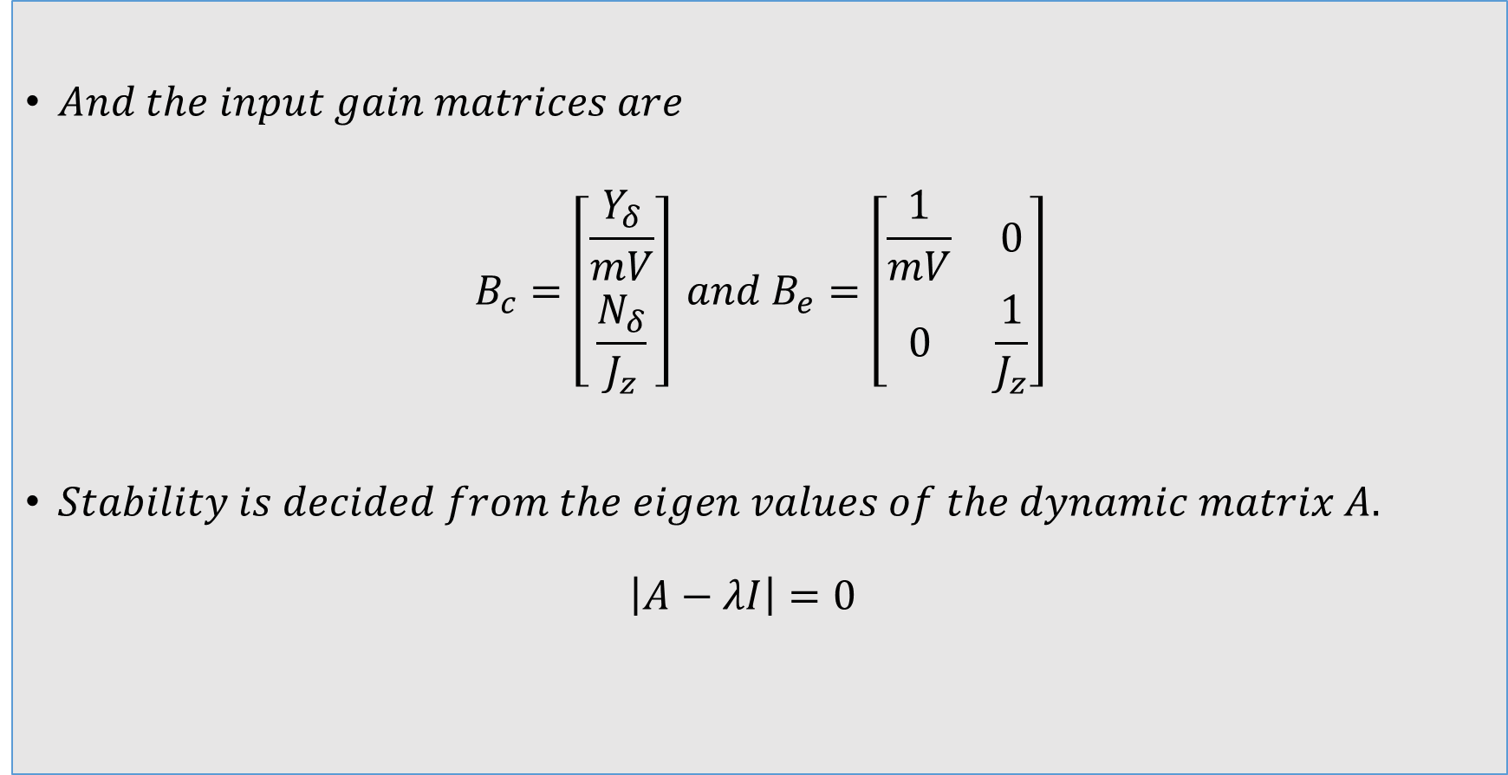
$And the input gain matrices are$
$$B_{c}=\left[\begin{matrix}\frac{Y_{δ}}{mV} \\ \frac{N_{δ}}{J_{z}}\end{matrix}\right] and B_{e}=\left[\begin{matrix}\frac{1}{mV} & 0 \\ 0 & \frac{1}{J_{z}}\end{matrix}\right]$$
$Stability is decided from the eigen values of the dynamic matrix A.$ $\left|A−λI\right|=0$

Slide 12
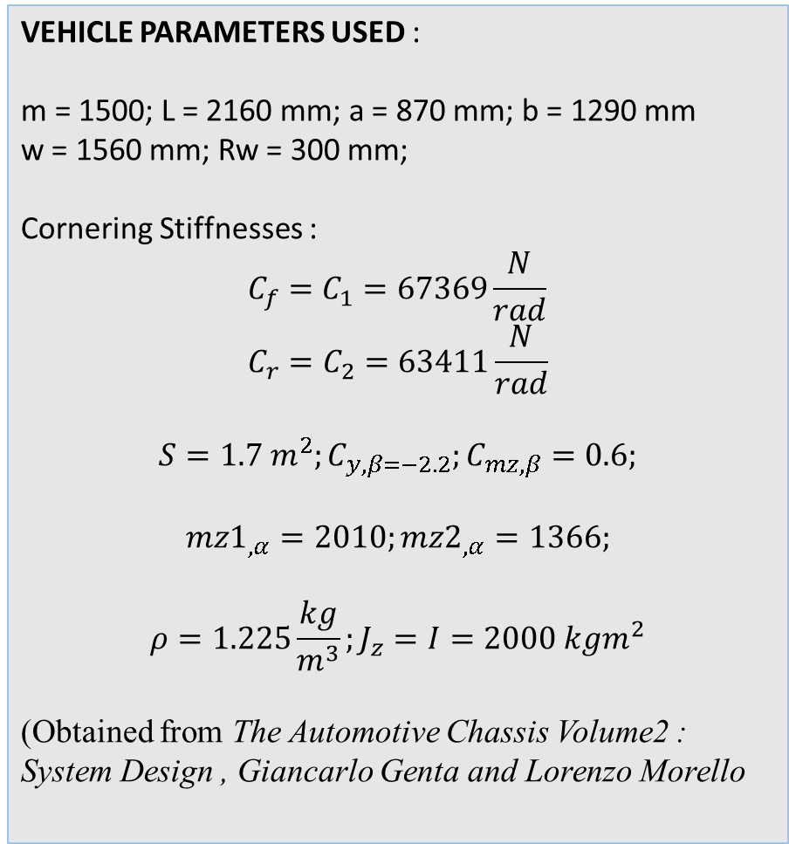
Vehicle Parameters and Model
VEHICLE PARAMETERS USED : m = 1500; L = 2160 mm; a = 870 mm; b = 1290 mm w = 1560 mm; Rw = 300 mm;
Cornering Stiffnesses :
$$C_{f}=C_{1}=67369\frac{N}{rad} \\ C_{r}=C_{2}=63411\frac{N}{rad}$$
$$S=1.7 m^{2};C_{y,β=−2.2};C_{mz,β}=0.6;$$
$$mz1_{,α}=2010;mz2_{,α}=1366;$$
$$ρ=1.225\frac{kg}{m^{3}};J_{z}=I=2000 kgm^{2}$$
(Obtained from The Automotive Chassis Volume2 : System Design , Giancarlo Genta and Lorenzo Morello
a
C.G
L
b
Single Track / Bicycle Model

Slide 13
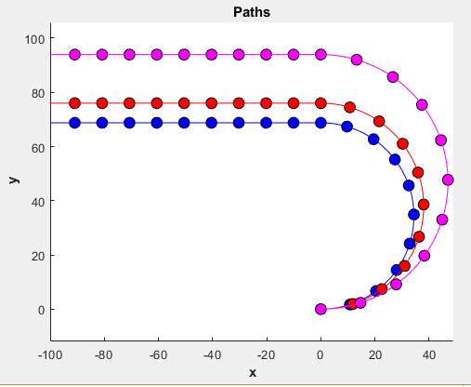
Paths Followed by Vehicles with understeers for different considerations
Under Kinematic Steering
Under Simplified Conditions
With Only Cornering Forces
By considering cornering forces, aerodynamic forces, aligning torques.

Slide 14
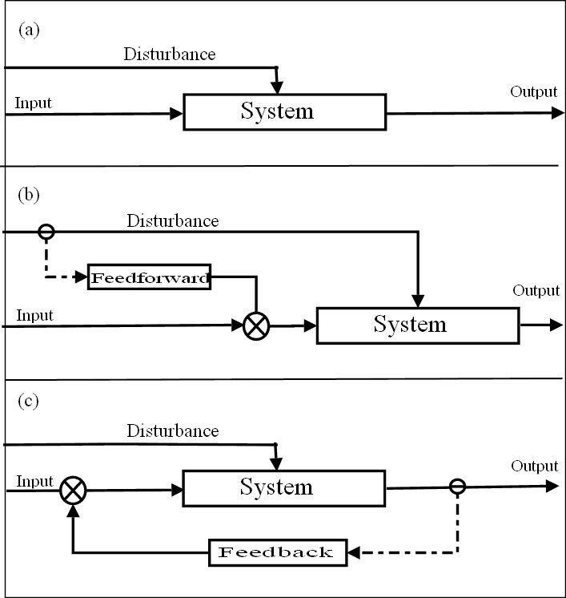
Types of Control Systems
Open Loop Control System
Feedforward Control System
Feedback Control System (Closed Loop)
Source: Wiki

Slide 15


Simple Feedforward Control With Yaw Moment as Input
Yaw Moment
Generator (From known math model)
L
R
Yaw Moment
Moment to Torque
System
(Vehicle)
Inputs : $δ, v$
Output : $\dot{ψ}$

Slide 16

Feedback Control Model
Controller
Desired Yaw Rate
Output Yaw Rate
Error
$M_{ze}$, Required Yaw Moment
L
Moment to Torque
R

Slide 17
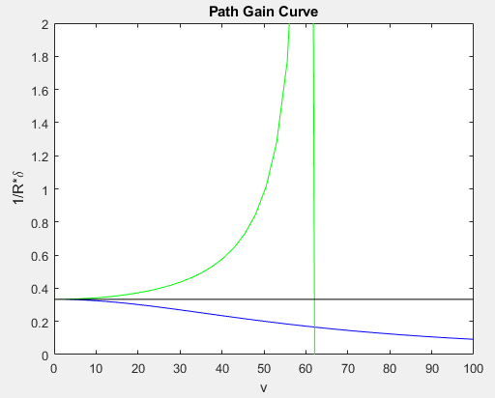
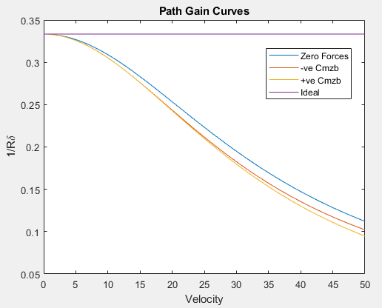
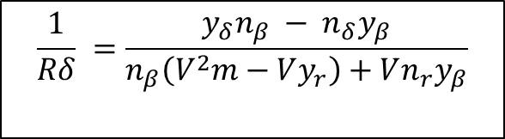

Path Gain Curves
$$\frac{1}{Rδ}=\frac{1}{l}\frac{1}{1+\frac{K_{us}V^{2}}{gl}}$$
$$\frac{1}{Rδ} =\frac{y_{δ}n_{β} − n_{δ}y_{β}}{n_{β}\left(V^{2}m−Vy_{r}\right)+Vn_{r}y_{β}}$$
Neglecting the aerodynamic forces and aligning torques.

Slide 18
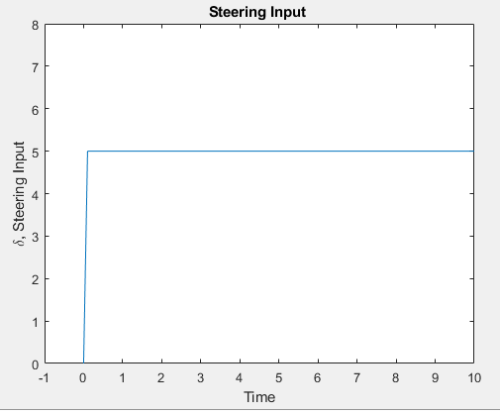
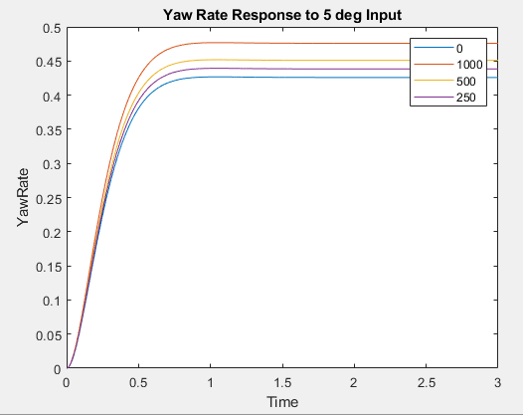
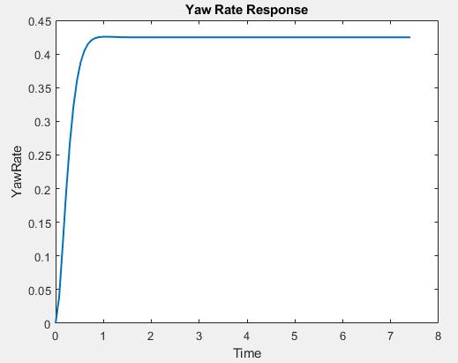
Yaw Rate Responses at Various Yaw Moments to 5 degree step steering Input
Steering Input
Yaw Rate (from ode45)

Slide 19
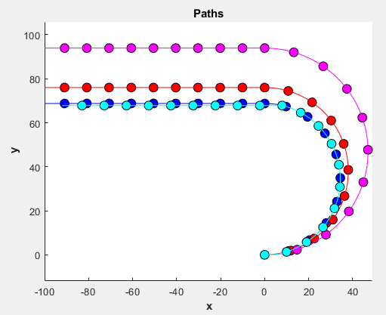
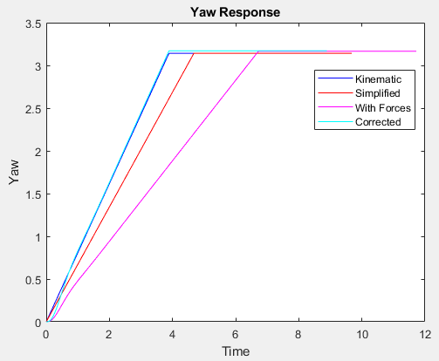
Corrected Path of Vehicle at 72 kmph
Path Followed by the Vehicle
Yaw Response of the Vehicle

Slide 20
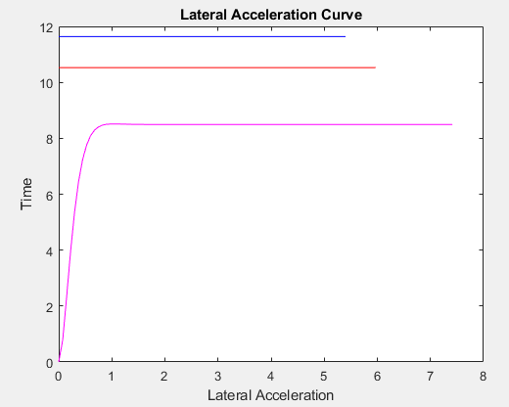
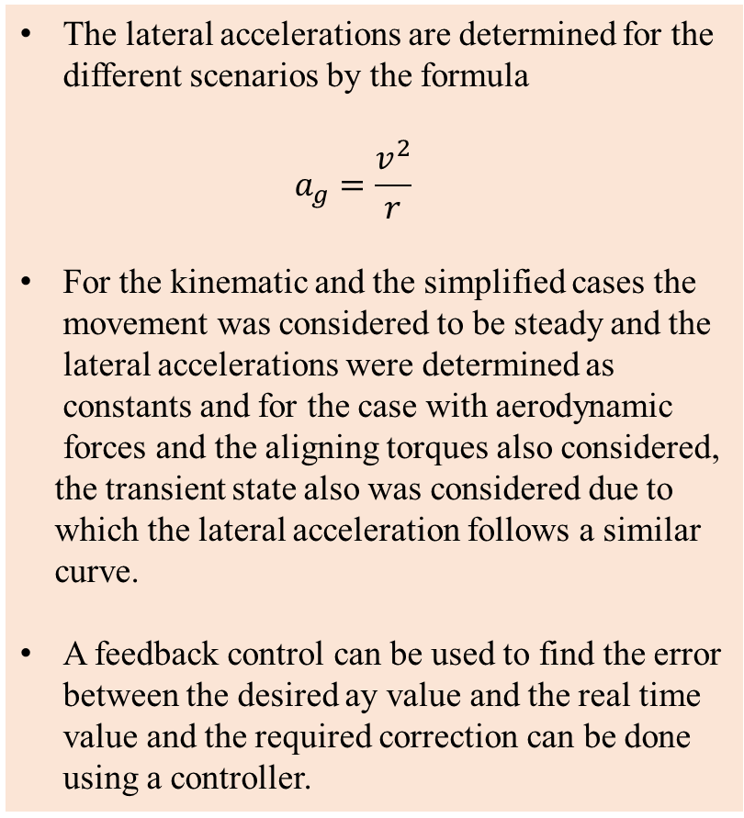
Lateral Acceleration Curves
The lateral accelerations are determined for the different scenarios by the formula $a_{g}=\frac{v^{2}}{r}$
For the kinematic and the simplified cases the movement was considered to be steady and the lateral accelerations were determined as constants and for the case with aerodynamic forces and the aligning torques also considered,
the transient state also was considered due to which the lateral acceleration follows a similar curve.
A feedback control can be used to find the error between the desired ay value and the real time value and the required correction can be done using a controller.

Slide 21
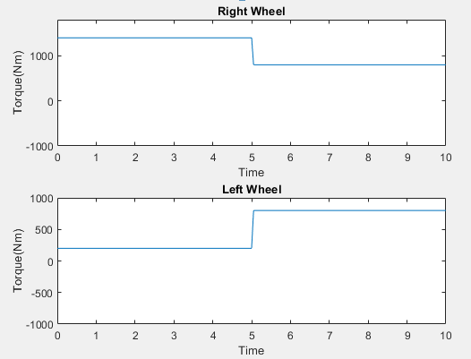
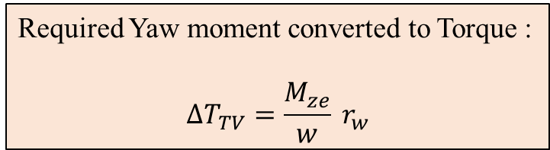
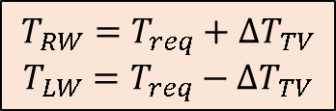
Distributed Torque to Left and Right Wheels at 72 kmph
Required Yaw moment converted to Torque :
$$ΔT_{TV}=\frac{M_{ze}}{w} r_{w}$$
$$T_{RW}=T_{req}+ΔT_{TV}$$
$$T_{LW}=T_{req}−ΔT_{TV}$$

Slide 22
Special Implementations
Active Yaw Control by Mitsubishi
Torque Vectoring Differential by Lexus
Dynamic Performance by BMW
Quattro with Torque Vectoring by Audi
Torque Vectoring by Mercedes Benz (4Matic)

Slide 23
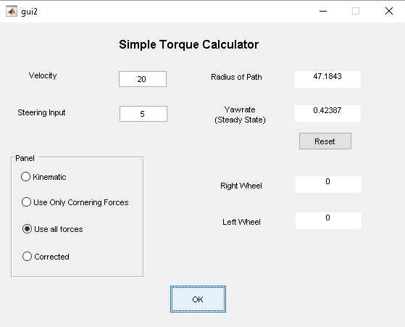
A Simple GUI for Torque Calculation
Uses a set of the vehicle parameters in this study to obtain the yaw rate and the path
radius.
For a step input of steering which can be entered to the application along with the velocity of the vehicle which formed the inputs to the system.
Scope for further additions like a variable steering input and an all wheel torque distribution for stable vehicle dynamics, the purpose served by the torque vectoring system.

Slide 24
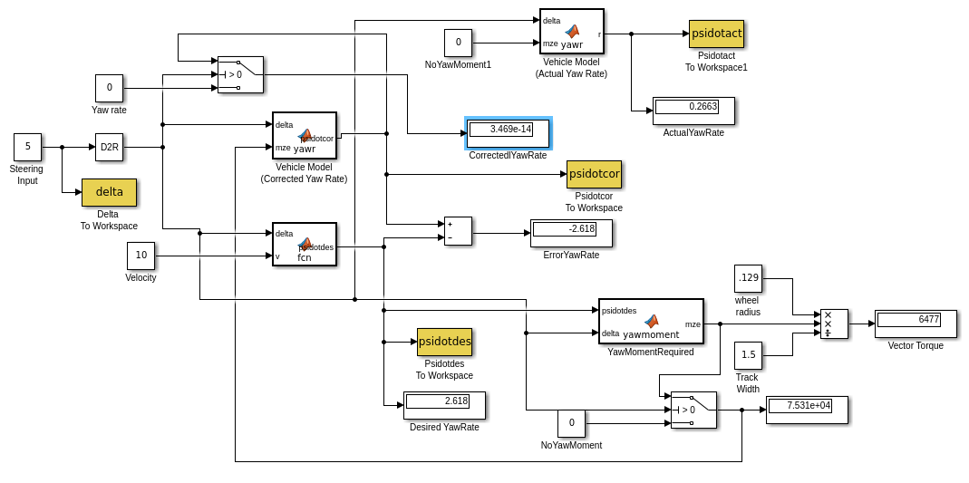
A Simple Simulink Feedforward Control

Slide 25
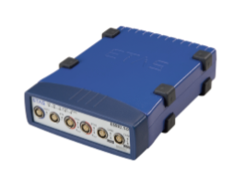
Control Systems Integration
The required torques are calculated from the inputs from the throttle.
The completed control system software developed using the Matlab-Simulink is compiled into C code. The code also contains the instructions necessary to communicate the information with the module on the vehicle.
Module Used for Communication with the vehicle. Src: (1)

Slide 26
References
Active Torque Vectoring Systems for Electric Drive Vehicles, Main Thesis, Martin Mondek, Czech Technical University in Prague.
A Torque Vectoring Strategy for Improving the Performance of a Rear Wheel Drive Electric Vehicle, Jyotishman Ghosh et al, Turin, Italy, 2015.
The Automotive Chassis Volume 2 : System Design, Giancarlo Genta and Lorenzo Morello.
Vehicle Stability by Dean Karnopp.
Video Ref : https://www.youtube.com/watch?v=AgqWcsivlAA by Protean Electric In_Wheel Drive Motors

Slide 27
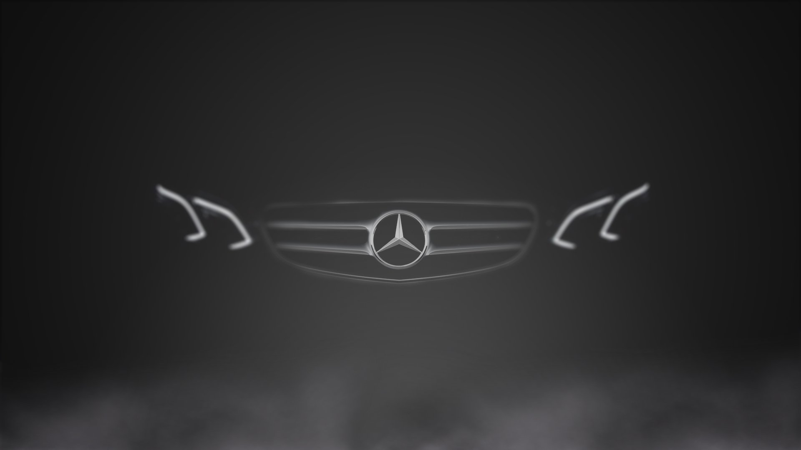
Dankeschӧn

Slide 28
Secondary Slides

Slide 29
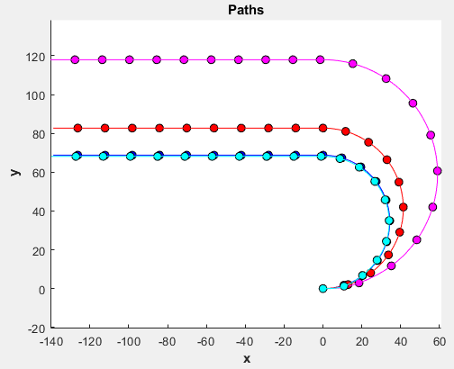
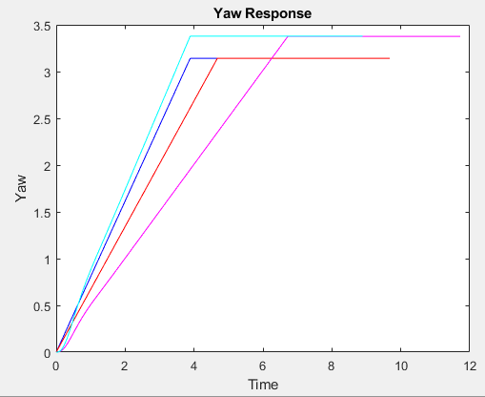
Corrected Path of Vehicle – at 100 kmph
Path Followed by the Vehicle
Yaw Response of the Vehicle

Slide 30
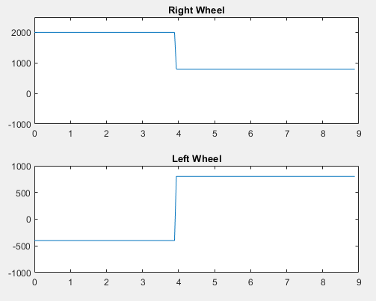
Distributed Torque to Left and Right Wheels at 100 kmph

Slide 31
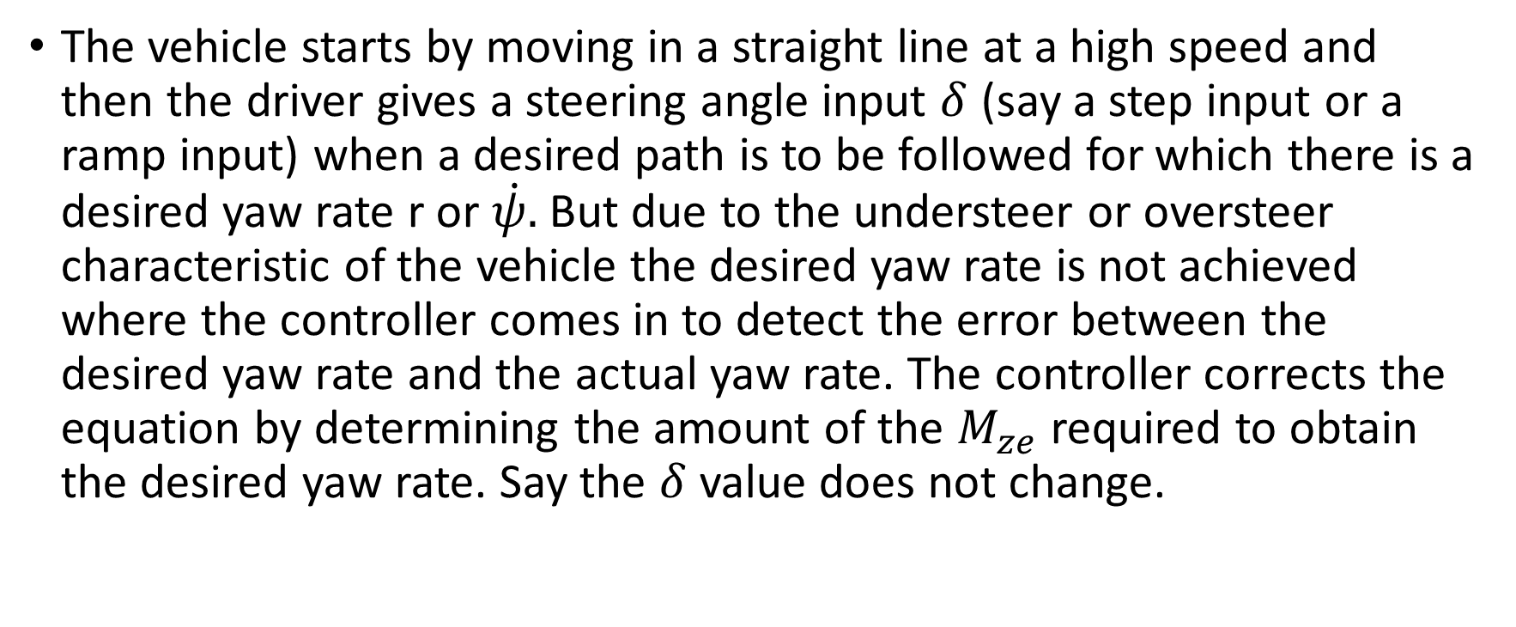
The vehicle starts by moving in a straight line at a high speed and then the driver gives a steering angle input $δ$ (say a step input or a ramp input) when a desired path is to be followed for which there is a desired yaw rate r or $\dot{ψ}.$ But due to the understeer or oversteer characteristic of the vehicle the desired yaw rate is not achieved where the controller comes in to detect the error between the desired yaw rate and the actual yaw rate. The controller corrects the equation by determining the amount of the $M_{ze}$ required to obtain the desired yaw rate. Say the $δ$ value does not change.

Slide 32
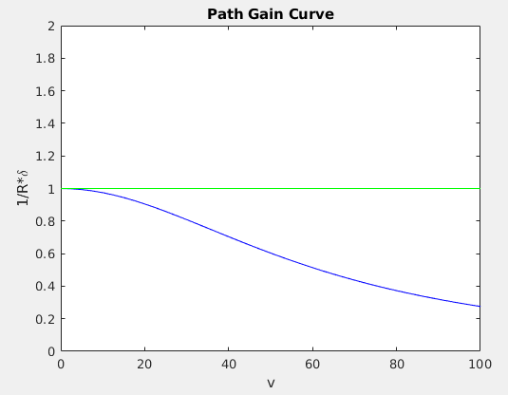
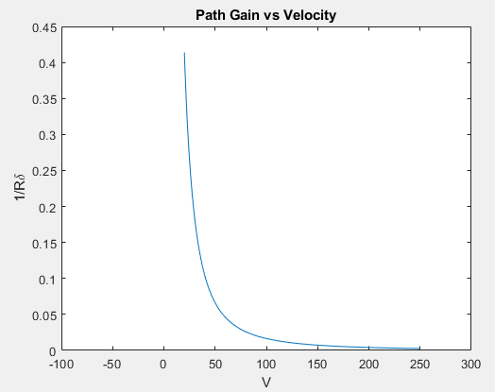

Slide 33
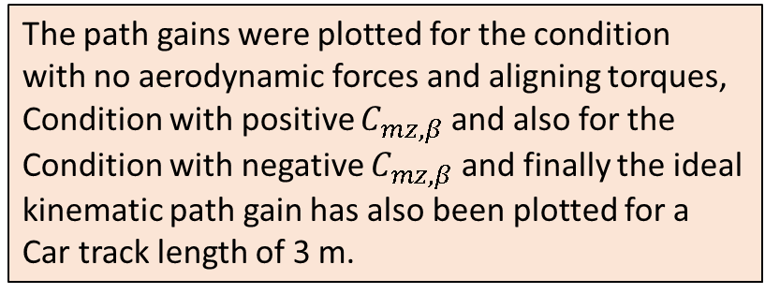
The path gains were plotted for the condition with no aerodynamic forces and aligning torques,
Condition with positive $C_{mz,β}$ and also for the
Condition with negative $C_{mz,β}$ and finally the ideal kinematic path gain has also been plotted for a
Car track length of 3 m.

Slide 34
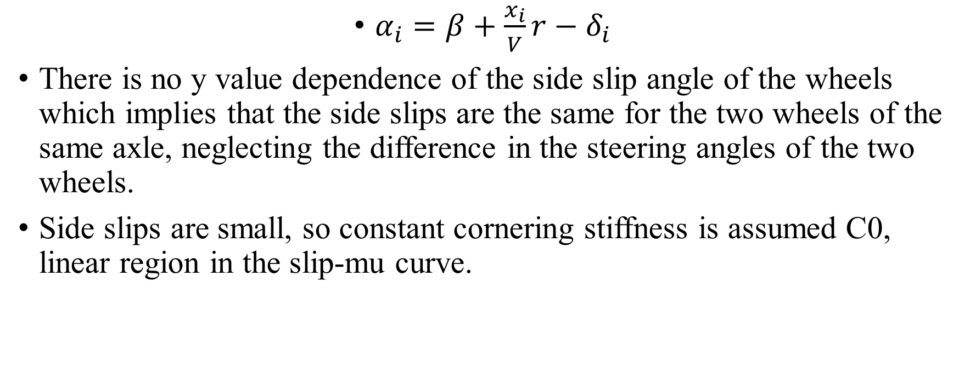
Why can a monotrack model be used?
$α_{i}=β+\frac{x_{i}}{V}r−δ_{i}$
There is no y value dependence of the side slip angle of the wheels which implies that the side slips are the same for the two wheels of the same axle, neglecting the difference in the steering angles of the two wheels.
Side slips are small, so constant cornering stiffness is assumed C0, linear region in the slip-mu curve.

Slide 35
Toe in and load transfer
Nor is allowance made for toe in and transversal load transfer. If the dependence of the cornering stiffness were linear with the load Fz, this would be correct since the increase of cornering stiffness of the more loaded wheel would exactly compensate for the decrease of the other wheel. As this is not exactly the case, the load transfer causes a decrease of the cornering stiffness of each axle, but this effect is usually considered negligible, at least for lateral accelerations lower than 0.5g.
Toe in causes in increase of the cornering stiffness of the axle if it is positive, a decrease if it is negative.

Slide 36
Aerodynamic Yawing Moment
The aerodynamic yaw moment produces a strong effect. If the derivative of Cz wrt beta is negative, the effect is increasing oversteer or decreasing understeer, at increasing speed. If a critical speed exists, such an aerodynamic effect lowers it and has an overall destabilising effect, increasing with the absolute value of Cmz,beta. Opposite occurs if Cmz,beta is positive.

Slide 37

Considering only cornering forces at steady state conditions $\frac{mV^{2}}{R}\cos\left(β\right)=ΣF_{x_{i}}\sin\left(δ_{i}\right)+ΣF_{y_{i}}cos⁡(δ_{i})$
$$ΣF_{x_{i}}sin\left(δ_{i}\right)x_{i}+ΣF_{y_{i}}\cos\left(δ_{i}\right)x_{i}=0$$
$$u=Vcos\left(β\right)≈V;v=Vsin\left(β\right)≈Vβ$$

Slide 38
Feedforward Control System
In this a control the output is known and assumed to be unchanging. A feedforward signal is input to the system and no output is fed back to any controller. Therefore it does not consider the response of the system which is a sort of a passive system. The error between the desired parameter and the response is not considered in such systems to modify the system response.

